Slide 1
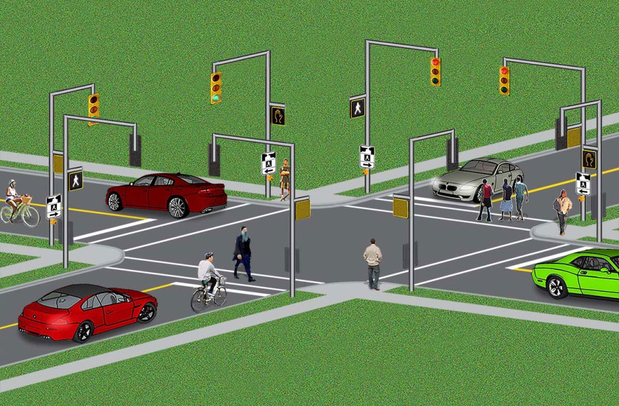
LEC 7
Traffic Signals Including Pedestrian Signals

Slide 2
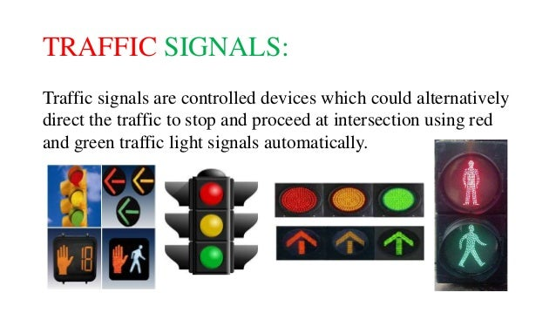
TRAFFIC SIGNALS
Traffic signals are controlled devices which could alternatively direct the traffic to stop and proceed at intersection using red and green traffic light signals automatically.

Slide 3
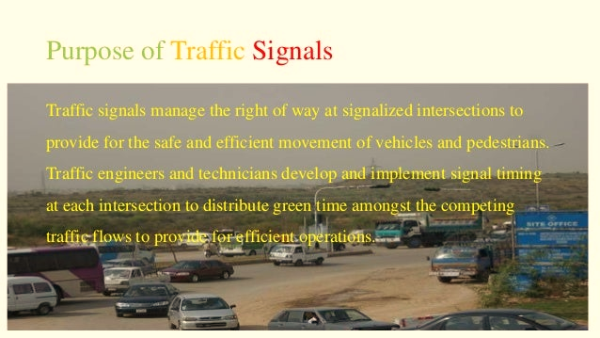
Purpose of Traffic Signals

Slide 4
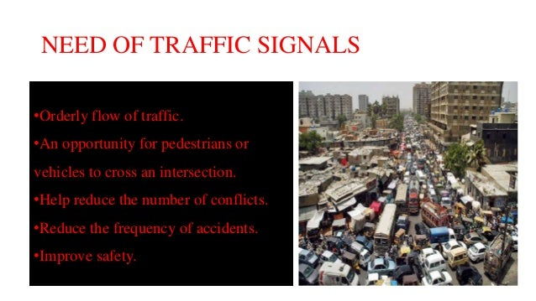
Need of Traffic Signal
An opportunity for pedestrian or
Vehicles to cross intersection
Help to reduce the number of conflicts
Reduce the frequency of accident
Improve Safety

Slide 5
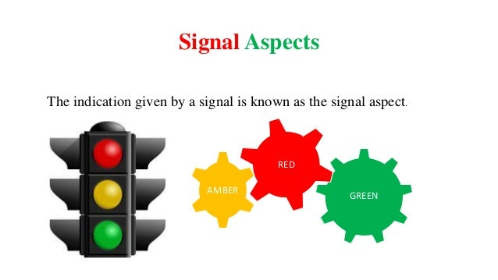
Signal Aspects
The indication given by a signal is known as the signal aspect.

Slide 6
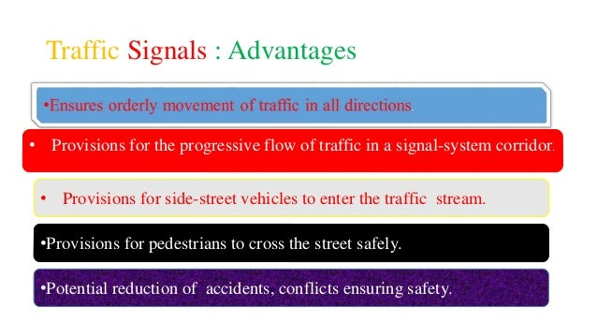
Traffic Signal Advantages

Slide 7
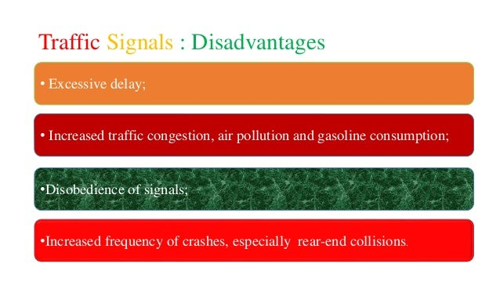
Traffic Signal Disadvantages

Slide 8
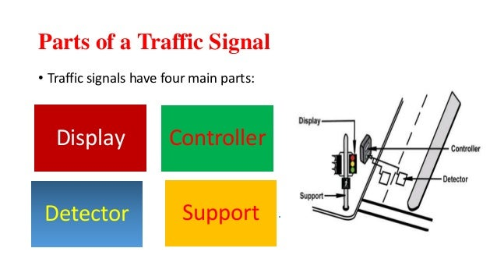
Parts of Traffic Signal
Traffic Signals have four main parts:

Slide 9
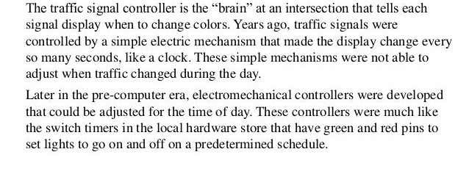
Signal Controller

Slide 10
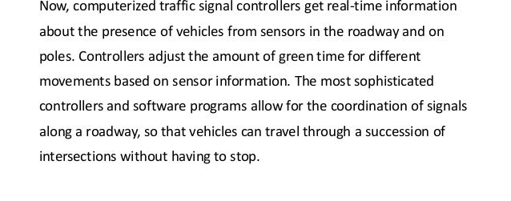
Signal Controller

Slide 11
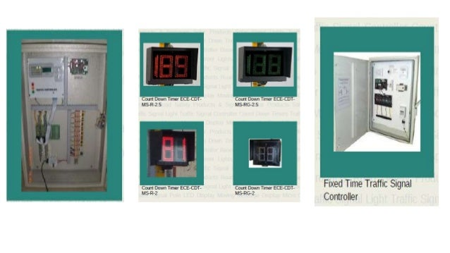
Signal Controller

Slide 12
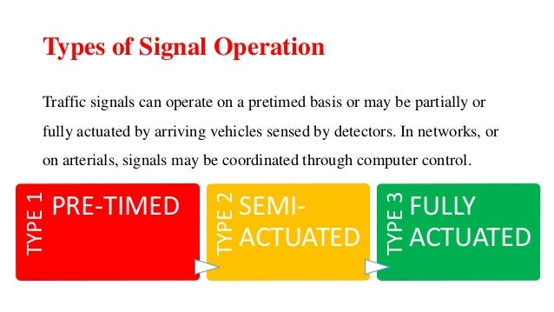
Types of Signal Operation

Slide 13
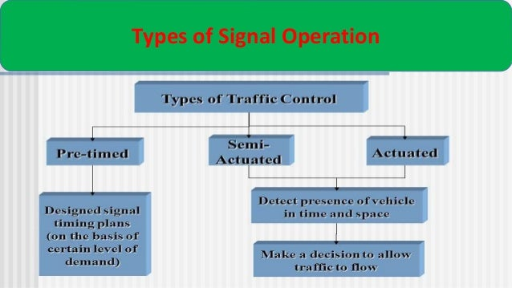
Types of Signal Operation

Slide 14
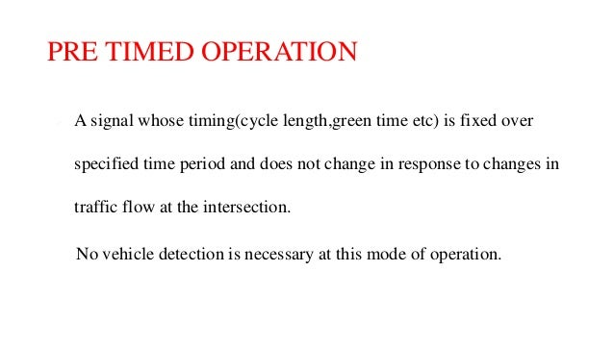
Pre -Timed Operation

Slide 15
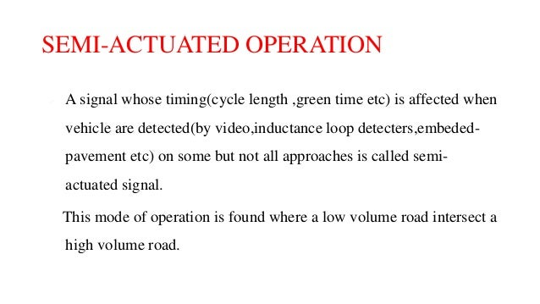
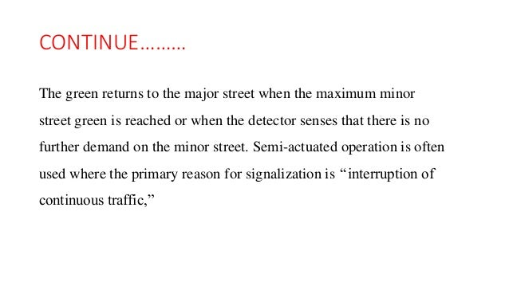
Semi Actuated Operation

Slide 16
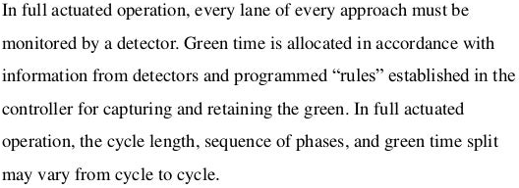
Actuated Operation

Slide 17
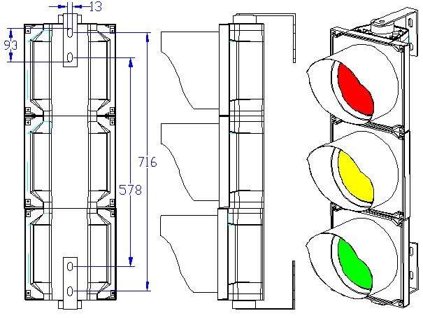
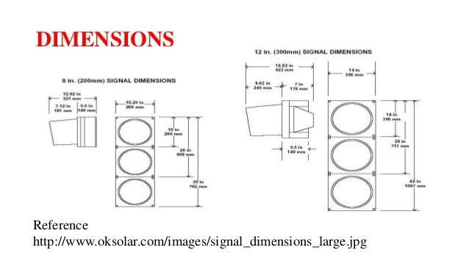
Dimensions

Slide 18
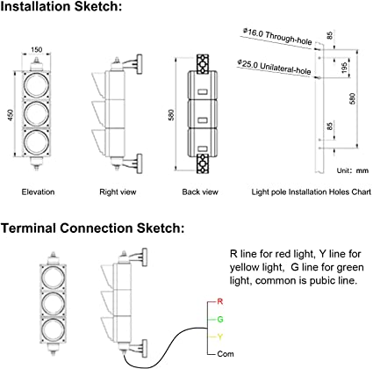
Dimensions

Slide 19
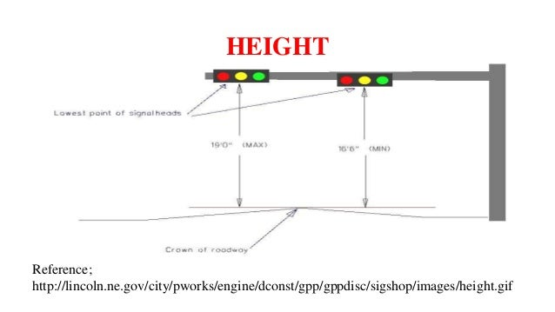
Height of Signal

Slide 20
Pedestrian Signals
Pedestrian signals are devices used at signalized intersections to notify pedestrians when it is safe to cross the street.
Modern pedestrian signals incorporate countdown timers into their design that display the number of seconds remaining before the signal changes to “Don’t Walk”.

Slide 21
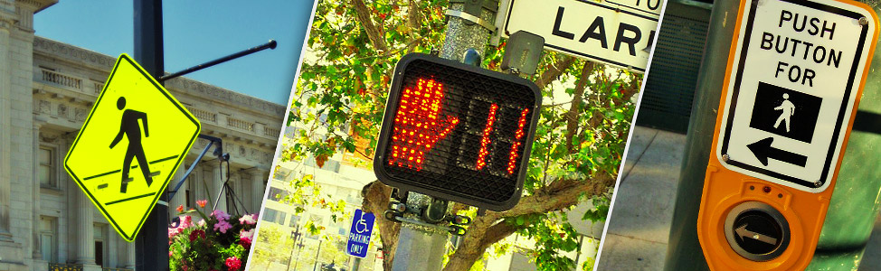
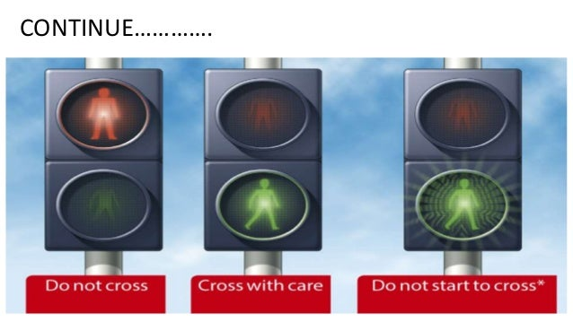
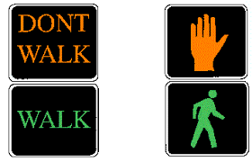
Pedestrian Signals

Slide 22

Pedestrian Signals
As a next step, conduct studies to determine if slower walking speeds are appropriate and, if so, what those speeds should be.
Pedestrian ‘scrambles’
Exclusive pedestrian phases (i.e. pedestrian ‘scrambles’) may be used where turning vehicles conflict with very high pedestrian volumes and pedestrian crossing distances are short.

Slide 23
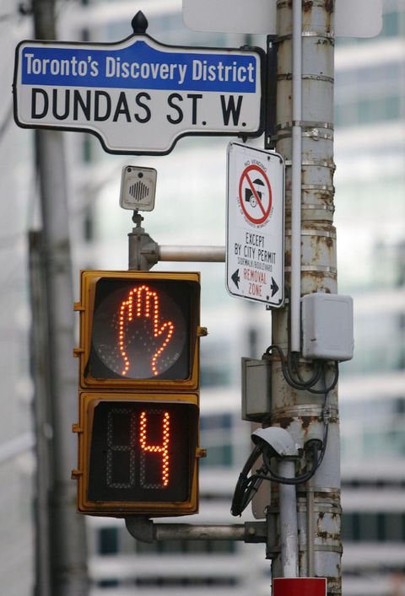
Pedestrian Signals
Pedestrian ‘head-start signals’
Leading pedestrian intervals, which give pedestrians a head start before vehicles are given the green, may be considered at signalized intersections with a high incidence of pedestrian conflicts and right-of-way violations.

Slide 24
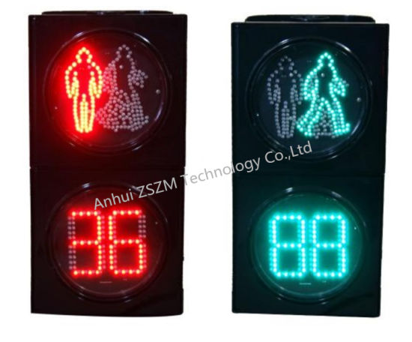
Pedestrian Signals
Pedestrian countdown signals
Pedestrian countdown signals are designed to enhance the effectiveness of pedestrian signals at clearing the crosswalk before a signal changes direction.
Surveys show that most people misinterpret the meaning of the flashing hand of the traditional pedestrian signal.
Providing the pedestrian countdown device helps pedestrians better interpret the pedestrian signals.
Countdowns also enable pedestrians to stop on a median refuge, where provided, and wait for the next phase if they find the time left to be too short to finish crossing.
Pedestrian countdown signals have been shown to have a 25% reduction in pedestrian injury collisions.

Slide 25
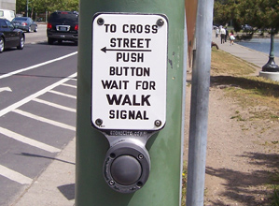
Pedestrian Signals
Pedestrian-actuated signals
Generally, signals on short, fixed time cycles should be used rather than actuated signals (pedestrian push-buttons) to allow consistent crossing opportunities.
Pedestrian actuation should only be used when pedestrian crossings are intermittent, at locations with relatively long pedestrian clearance time that can result in excessive delay to transit vehicles, and to activate audible pedestrian signals or to provide an extended WALK interval.
Since many pedestrians fail to notice pushbutton devices, additional research on passive video and infra-red detection should be conducted.
Timed progression of traffic signals should ensure that sufficient time is allocated per cycle for pedestrian crossings.

